Slide 1

OMEGA PSI PHI FRATERNITY, INC.
Omega Dears
Initiative
A chapter-based model for sustaining connection, care and friendship with the widows of our transitioned Brothers.
Kappa Alpha Alpha Chapter • Decatur, Georgia
Bro. Darrell DeShazier, Chairman
Notes:
[Sources]
- User-provided Omega Dears Initiative presentation; content and authentic visual assets reformatted for executive presentation.

Slide 2

OMEGA DEARS INITIATIVE
A commitment that continues beyond transition
FOUNDED MAY 2020
The Omega Dears Initiative was created by the Brothers of Kappa Alpha Alpha Chapter to maintain meaningful, consistent connection with the widows of Brothers who have entered Omega Chapter.
Identify Recognize eligible widows following official chapter notification.
Connect Maintain monthly communication, invitations and wellness checks.
Listen Bring needs and recommendations to chapter leadership for response.
Welcome Participation is always voluntary—and the invitation remains open.
OUR PROMISE
Build relationships that embody
“Friendship Forever.”
Kappa Alpha Alpha Chapter • “Friendship Forever”
02
Notes:
[Sources]
- User-provided Omega Dears Initiative presentation; content and authentic visual assets reformatted for executive presentation.

Slide 3
OMEGA DEARS INITIATIVE
Four commitments define the operating model
01
CONSISTENT CONNECTION
02
MONTHLY ENGAGEMENT
Establish a dependable communication channel with every participating Omega Dear.
Include chapter invitations, holiday cards, wellness checks and personal outreach.
03
RESPONSIVE SUPPORT
04
LASTING FRIENDSHIP
Gather recommendations, elevate needs and close the loop with a thoughtful chapter response.
Ensure each widow knows the chapter remembers her, values her and remains connected as one Omega family.
Kappa Alpha Alpha Chapter • “Friendship Forever”
03
Notes:
[Sources]
- User-provided Omega Dears Initiative presentation; content and authentic visual assets reformatted for executive presentation.

Slide 4
LIVING YOUR CREED
A disciplined five-step path enables chapter adoption
1
ALIGN
Brief the Basileus and chapter on the initiative and its purpose.
2
ASSESS
Confirm the initiative is viable and supported within the chapter.
3
SELECT
Appoint a focused chairman and committee members.
4
FORMALIZE
Establish bylaws, charter and mission statement as appropriate.
5
ACTIVATE
Launch outreach and engage Bro. Darrell DeShazier for guidance.
Kappa Alpha Alpha Chapter • “Friendship Forever”
04
Notes:
[Sources]
- User-provided Omega Dears Initiative presentation; content and authentic visual assets reformatted for executive presentation.

Slide 5
THE WAY AHEAD
National approval opens the path for wider chapter adoption
ESTABLISHED
NATIONAL APPROVAL
7th District
85th Grand Conclave, 2026
Officially approved and implemented across all Graduate Chapters within the district, with active sponsorship and support from Immediate Past Grand Chaplain Roi Johnson.
The 85th Grand Conclave approved the Omega Dears Initiative as an official national initiative.
CALL TO ACTION
District responsibility
Graduate Chapters across all Districts are encouraged to adopt and implement the initiative.
Promote, advance and sustain the initiative.
Kappa Alpha Alpha Chapter • “Friendship Forever”
05
Notes:
[Sources]
- User-provided Omega Dears Initiative presentation; content and authentic visual assets reformatted for executive presentation.

Slide 6

OMEGA MEN • SPIRITUAL FOUNDATION
Our spiritual duty is clear: remember, protect and serve
PROTECT
God is the Father of the fatherless and protector of widows.
Psalm 68:5
ADVOCATE
Seek justice, correct oppression and plead the widow’s cause.
Isaiah 1:17
SERVE
What we do for the least of these, we do in service to the King.
Matthew 25:40
HONOR
Honor widows who are truly widows.
1 Timothy 5:3
VISIT
Pure religion includes visiting widows in their affliction.
James 1:27
Kappa Alpha Alpha Chapter • “Friendship Forever”
06
Notes:
[Sources]
- User-provided Omega Dears Initiative presentation; content and authentic visual assets reformatted for executive presentation.

Slide 7

MILESTONE
From chapter vision
to official initiative
Omega Dears became an official initiative at the 85th Grand Conclave.
CINCINNATI, OHIO • JULY 30–AUGUST 3, 2026
Notes:
[Sources]
- User-provided Omega Dears Initiative presentation; content and authentic visual assets reformatted for executive presentation.

Slide 8
CONTACT INFORMATION
Leadership contacts support adoption and implementation
OMEGA LEADERSHIP
COMMITTEE CONTACTS
GRAND CHAPLAIN
Bro. Tim Sims
Bro. Mohandas Martin
Bro. Courtenay Miller
(404) 660-4375
(706) 951-1915
timasims@me.com
dinoquesix@gmail.com
(202) 374-6411
courtenaymiller@aol.com
Bro. Dr. Kevin Scott
Bro. Marvin Broadwater Sr.
(248) 668-6104
(706) 315-6454
IMMEDIATE PAST GRAND CHAPLAIN
kevinscott1911@comcast.net
mbroadwatersr@yahoo.com
Bro. Roi Johnson
(404) 578-0647
Bro. John Copper
Bro. Robert Cunningham
johnsonroi@yahoo.com
(210) 602-7901
(919) 906-0924
cjd78230@gmail.com
jcsu80@aol.com
GEORGIA STATE CHAPLAIN
Bro. Tavious Mays
Bro. Andre Sims
Bro. Dwight Wester
(770) 820-8392
(757) 615-1323
(706) 464-0045
andre.sims@wnco.com
redsea80@gmail.com
jabque3@hotmail.com
Kappa Alpha Alpha Chapter • “Friendship Forever”
08
Notes:
[Sources]
- User-provided Omega Dears Initiative presentation; content and authentic visual assets reformatted for executive presentation.

Slide 9
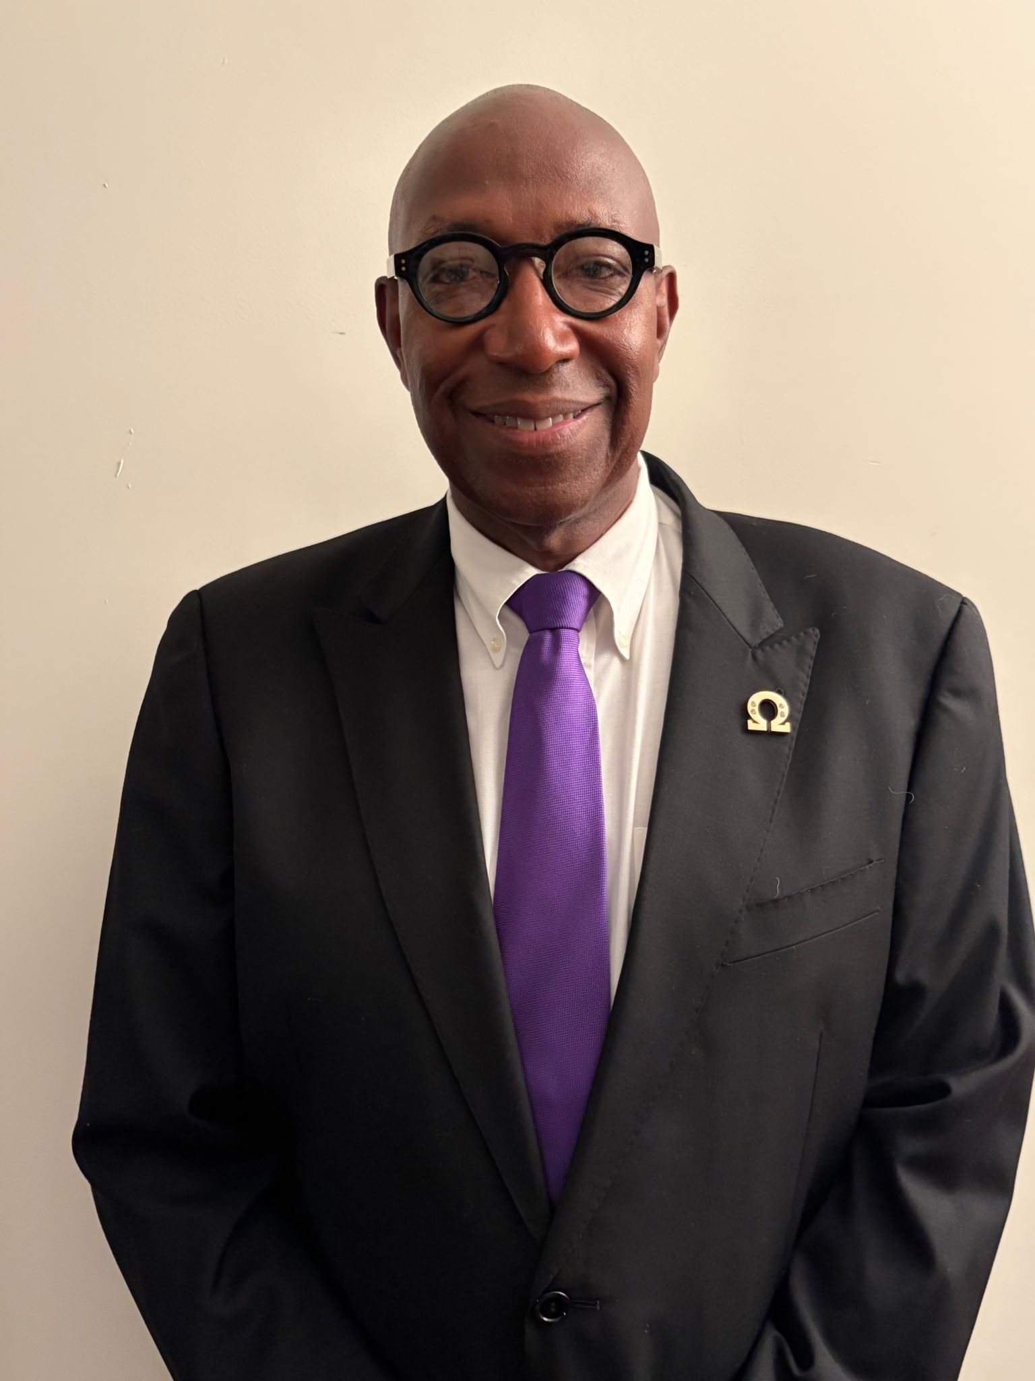
OMEGA DEARS INITIATIVE
Friendship
without an expiration date.
Remember the widows.
Sustain the relationship.
Live Your Creed.
BRO. DARRELL DESHAZIER “DOUBLE D”
Chairman, Omega Dears Initiative
Kappa Alpha Alpha Chapter, Decatur, Georgia
(678) 296-3699
darrelldeshazier@yahoo.com
Notes:
[Sources]
- User-provided Omega Dears Initiative presentation; content and authentic visual assets reformatted for executive presentation.

